Slide 1

One-to-One and Recursive Relationships
Self-reflection is the school of wisdom
Baltastar Gracián

Slide 2
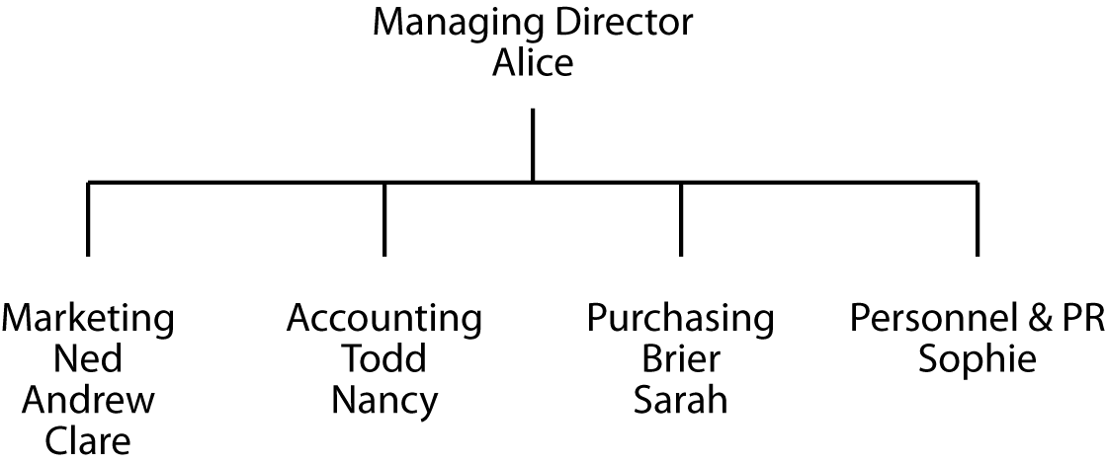
An organization chart

Slide 3
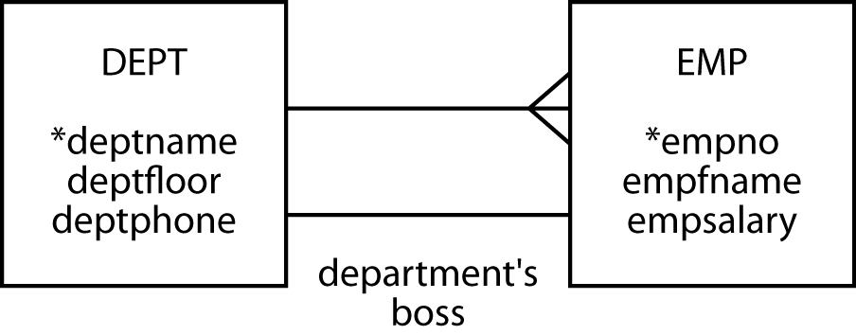
Modeling a 1:1 relationship
1:1 relationship is labeled
  A relationship descriptor
Obvious relationships are not labeled

Slide 4
Modeling a recursive relationship
A recursive relationship relates an entity to itself
Label recursive relationships

Slide 5
Mapping a 1:1 relationship
Usual rules apply
Where do you put the foreign key?
  DEPT
  EMP
  Both tables

Slide 6
Mapping a recursive relationship
Usual rules
1:m
  The entity gets an additional column for the foreign key
  Need a name different from the primary key

Slide 7
Results of mapping
dept
deptname | deptfloor | deptphone | empno
Management | 5 | 2001 | 1
Marketing | 1 | 2002 | 2
Accounting | 4 | 2003 | 5
Purchasing | 4 | 2004 | 7
Personnel & PR | 1 | 2005 | 9
emp
empno | empfname | empsalary | deptname | bossno
1 | Alice | 75000 | Management
2 | Ned | 45000 | Marketing | 1
3 | Andrew | 25000 | Marketing | 2
4 | Clare | 22000 | Marketing | 2
5 | Todd | 38000 | Accounting | 1
6 | Nancy | 22000 | Accounting | 5
7 | Brier | 43000 | Purchasing | 1
8 | Sarah | 56000 | Purchasing | 7
9 | Sophie | 35000 | Personnel & PR | 1

Slide 8
Creating the tables
CREATE TABLE dept (
deptname VARCHAR(15),
deptfloor SMALLINT NOT NULL,
deptphone SMALLINT NOT NULL,
empno SMALLINT NOT NULL,
PRIMARY KEY(deptname));
CREATE TABLE emp (
empno SMALLINT,
empfname VARCHAR(10),
empsalary DECIMAL(7,0),
deptname VARCHAR(15),
bossno SMALLINT,
PRIMARY KEY(empno),
CONSTRAINT fk_belong_dept FOREIGN KEY(deptname)
REFERENCES dept(deptname),
CONSTRAINT fk_has_boss foreign key (bossno)
REFERENCES emp(empno));

Slide 9
Inserting rows
INSERT INTO emp (empno, empfname, empsalary, deptname)
VALUES (1,'Alice',75000,'Management');
INSERT INTO emp VALUES (2,'Ned',45000,'Marketing',1);
INSERT INTO emp VALUES (3,'Andrew',25000,'Marketing',2);
INSERT INTO emp VALUES (4,'Clare',22000,'Marketing',2);
INSERT INTO emp VALUES (5,'Todd',38000,'Accounting',1);
INSERT INTO emp VALUES (6,'Nancy',22000,'Accounting',5);
INSERT INTO emp VALUES (7,'Brier',43000,'Purchasing',1);
INSERT INTO emp VALUES (8,'Sarah',56000,'Purchasing',7);
INSERT INTO emp VALUES (9,'Sophie',35000,'Personnel',1);

Slide 10
Querying a 1:1 relationship
List the salary of each department’s boss.
SELECT empfname, deptname, empsalary FROM emp
WHERE empno IN (SELECT empno FROM dept);
empfname | deptname | empsalary
Alice | Management | 75000
Ned | Marketing | 45000
Todd | Accounting | 38000
Brier | Purchasing | 43000
Sophie | Personnel & PR | 35000

Slide 11
Querying a recursive relationship
Find the salary of Nancy’s boss.
SELECT wrk.empfname, wrk.empsalary, boss.empfname, boss.empsalary
FROM emp wrk, emp boss
WHERE wrk.empfname = 'Nancy'
AND wrk.bossno = boss.empno;
wrk.empfname | wrk.empsalary | boss.empfname | boss.empsalary
Nancy | 22000 | Todd | 3800

Slide 12
Joining a table with itself
emp
empno | empfname | empsalary |  | deptname | bossno
1 | Alice | 75000 |  | Management
2 | Ned | 45000 |  | Marketing | 1
3 | Andrew | 25000 |  | Marketing | 2
4 | Clare | 22000 |  | Marketing | 2
5 | Todd | 38000 |  | Accounting | 1
6 | Nancy | 22000 |  | Accounting | 5
7 | Brier | 43000 |  | Purchasing | 1
8 | Sarah | 56000 |  | Purchasing | 7
9 | Sophie | 35000 |  | Personnel & PR | 1
emp
empno | empfname | empsalary |  | deptname | bossno
1 | Alice | 75000 |  | Management
2 | Ned | 45000 |  | Marketing | 1
3 | Andrew | 25000 |  | Marketing | 2
4 | Clare | 22000 |  | Marketing | 2
5 | Todd | 38000 |  | Accounting | 1
6 | Nancy | 22000 |  | Accounting | 5
7 | Brier | 43000 |  | Purchasing | 1
8 | Sarah | 56000 |  | Purchasing | 7
9 | Sophie | 35000 |  | Personnel & PR | 1

Slide 13
Querying a recursive relationship
Find the names of employees who earn more than their boss.
SELECT wrk.empfname
FROM emp wrk, emp boss
WHERE wrk.bossno = boss.empno
AND wrk.empsalary > boss.empsalary;
wrk |  |  |  |  |  | boss
empno | empfname | empsalary | deptname |  | bossno | empno | empfname | empsalary | deptname |  | bossno
2 | Ned | 45,000 | Marketing |  | 1 | 1 | Alice | 75,000 | Management
3 | Andrew | 25,000 | Marketing |  | 2 | 2 | Ned | 45,000 | Marketing |  | 1
4 | Clare | 22,000 | Marketing |  | 2 | 2 | Ned | 45,000 | Marketing |  | 1
5 | Todd | 38,000 | Accounting |  | 1 | 1 | Alice | 75,000 | Management
6 | Nancy | 22,000 | Accounting |  | 5 | 5 | Todd | 38,000 | Accounting |  | 1
7 | Brier | 43,000 | Purchasing |  | 1 | 1 | Alice | 75,000 | Management
8 | Sarah | 56,000 | Purchasing |  | 7 | 7 | Brier | 43,000 | Purchasing |  | 1
9 | Sophie | 35,000 | Personnel & PR |  | 1 | 1 | Alice | 75,000 | Management
empfname
Sarah

Slide 14
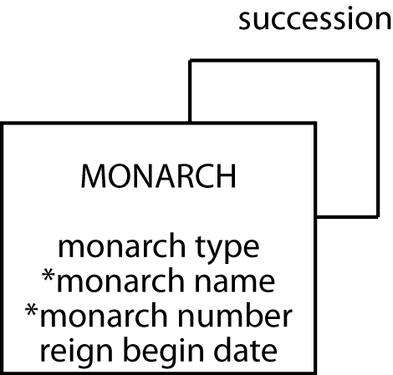
Modeling a 1:1 recursive relationship
The English monarchy

Slide 15
Mapping a 1:1 recursive relationship
monarch
montype | monname | monnum | rgnbeg | premonname | premonnum
Queen | Victoria | I | 1837/6/20 | William | IV
King | Edward | VII | 1901/1/22 | Victoria | I
King | George | V | 1910/5/6 | Edward | VII
King | Edward | VIII | 1936/1/20 | George | V
King | George | VI | 1936/12/11 | Edward | VIII
Queen | Elizabeth | II | 1952/2/6 | George | VI

Slide 16
Creating the table
CREATE TABLE monarch (
montype VARCHAR(5),
monname VARCHAR(15) NOT NULL,
monnum VARCHAR(5) NOT NULL,
rgnbeg DATE,
premonname VARCHAR(15),
premonnum VARCHAR(5),
PRIMARY KEY(monname,monnum),
CONSTRAINT fk_monarch
FOREIGN KEY (premonname, premonnum)
REFERENCES monarch(monname, monnum));

Slide 17
Inserting rows
INSERT INTO monarch (montype,monname, monnum,rgnbeg)
VALUES ('King','William','IV','1830-06-26');
INSERT INTO monarch
VALUES ('Queen','Victoria','I','1837-06-20','William','IV');
INSERT INTO monarch
VALUES ('King','Edward','VII','1901-01-22','Victoria','I');
INSERT INTO monarch
VALUES ('King','George','V','1910-05-06','Edward','VII');
INSERT INTO monarch
VALUES ('King','Edward','VIII','1936-01-20','George','V');
INSERT INTO monarch
VALUES ('King','George','VI','1936-12-11','Edward','VIII');
INSERT INTO monarch
VALUES 'Queen','Elizabeth','II','1952-02-06','George','VI');

Slide 18
Querying a 1:1 recursive relationship
Who preceded Elizabeth II?
SELECT premonname, premonnum FROM monarch
WHERE monname = 'Elizabeth' and monnum = 'II';
premonname | premonnum
George | VI

Slide 19
Querying a 1:1 recursive relationship
Was Elizabeth II's predecessor a king or queen?
SELECT pre.montype FROM monarch cur, monarch pre
WHERE cur.premonname = pre.monname
AND cur.premonnum = pre.monnum
AND cur.monname = 'Elizabeth'
AND cur.monnum = 'II';
montype
King

Slide 20
Querying a 1:1 recursive relationship
List the kings and queens of England in ascending chronological order.
SELECT montype, monname, monnum, rgnbeg
FROM monarch ORDER BY rgnbeg;
montype | monname | monnum | rgnbeg
Queen | Victoria | I | 1837-06-20
King | Edward | VII | 1901-01-22
King | George | V | 1910-05-06
King | Edward | VIII | 1936-01-20
King | George | VI | 1936-12-11
Queen | Elizabeth | II | 1952-02-06

Slide 21
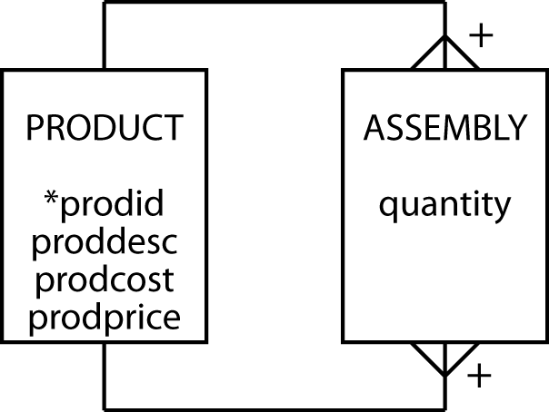
Modeling an m:m recursive relationship
Bill of materials problem
A product can appear as part of many other products and can be made up of many products

Slide 22
Mapping an m:m recursive relationship
product
prodid | proddesc | prodcost | prodprice
1000 | Animal photography kit |  | 725
101 | 35mm camera | 150 | 300
102 | Camera case | 10 | 15
103 | 70-210 zoom lens | 125 | 200
104 | 28-85 zoom lens | 115 | 185
105 | Photographer’s vest | 25 | 40
106 | Lens cleaning cloth | 1 | 1.25
107 | Tripod | 35 | 45
108 | 24 exposure, 100 ASA, 35mm color negative film | .85 | 1
assembly
quantity | prodid | subprodid
1 | 1000 | 101
1 | 1000 | 102
1 | 1000 | 103
1 | 1000 | 104
1 | 1000 | 105
2 | 1000 | 106
1 | 1000 | 107
10 | 1000 | 108

Slide 23
Creating the tables
CREATE TABLE product (
prodid INTEGER,
proddesc VARCHAR(30),
prodcost DECIMAL(9,2),
prodprice DECIMAL(9,2),
PRIMARY KEY(prodid));
CREATE TABLE assembly (
quantity INTEGER NOT NULL,
prodid INTEGER,
subprodid INTEGER,
PRIMARY KEY(prodid, subprodid),
CONSTRAINT fk_assembly_product FOREIGN KEY(prodid)
REFERENCES product(prodid),
CONSTRAINT fk_assembly_subproduct FOREIGN KEY(subprodid)
REFERENCES product (prodid));

Slide 24
Querying an m:m recursive relationship
List the product identifier of each component of the animal photography kit.
SELECT subprodid FROM product, assembly
WHERE proddesc = 'Animal photography kit'
AND product.prodid = assembly.prodid;
subprodid
101
106
107
105
104
103
102
108

Slide 25
Querying an m:m recursive relationship
List the product description and cost of each component of the animal photography kit.
SELECT proddesc, prodcost FROM product
WHERE prodid IN
(SELECT subprodid FROM product, assembly
WHERE proddesc = 'Animal photography kit'
AND product.prodid = assembly.prodid);
proddesc | prodcost
35mm camera | 150.00
Camera case | 10.00
70-210 zoom lens | 125.00
28-85 zoom lens | 115.00
Photographer’s vest | 25.00
Lens cleaning cloth | 1.00
Tripod | 35.00
24 exp. 100ASA 35mm col neg | 0.85

Slide 26
Conclusion
Introduced
  Recursive relationship
  Self-referential constraint
  Self-join

